Slide 1
Intro to Machine learning
CSS2

Slide 2
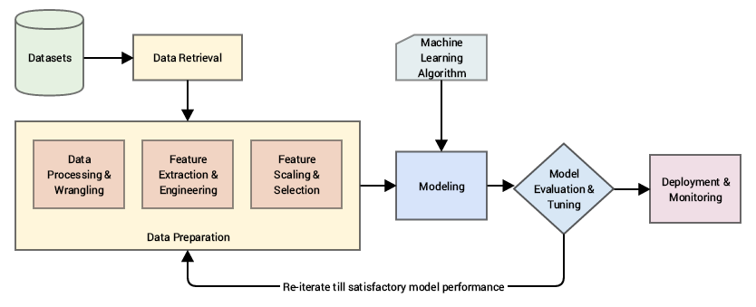

Slide 5
What is machine learning?
Its not the magic solution that will magically answer all of your wishes
Effective use of machine learning requires a good grasp of the strengths and weaknesses of different methods
Garbage in -> garbage out
Machine learning is where computation and algorithm meet statistics
Use machine learning for exploration and understanding through mathematical models

Slide 6
Machine learning isn’t just one method:
But it is usually separated into two types
Supervised
Involves modeling relationship between features and some label associated with them
Label could be categorical = binary classification
Label could be continuous = linear regression
Unsupervised
Involves modeling relationship between features without having a label
Letting data speak for itself!

Slide 7
The learning part of machine learning refers to the fact that we ‘tune’ parameters
Basically, like humans, the models “learn” from the data
In practice, our goal will be typically be:
Tune parameters of a model on some data
Training data
Sometimes, this is further broken down into training and validation (get back to this later)
Supervised: Predict and understand aspects of new data
Testing data

Slide 8
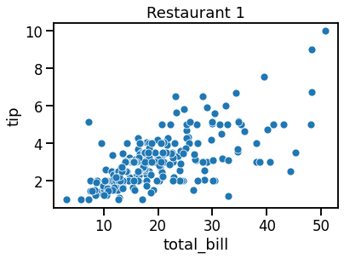
Let’s look at some examples
Example 1: linear regression
Let’s say, I want to predict how much the tip is going to based on the total bill in Restaurant 1

Slide 9
Let’s look at some examples
Example 1: linear regression
Let’s say, I want to predict how much the tip is going to based on the total bill in Restaurant 1
y = m*x + b
m = slope
b = intercept

Slide 10
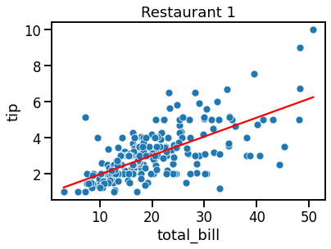
Let’s look at some examples
Example 1: linear regression
Let’s say, I want to predict how much the tip is going to based on the total bill in Restaurant 1
y = m*x + b
m = slope
b = intercept
y = .1*x + 0.9

Slide 11
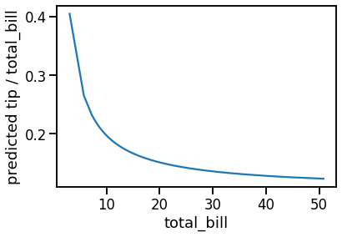
Let’s look at some examples
Example 1: linear regression
Let’s say, I want to predict how much the tip is going to based on the total bill in Restaurant 1
y = m*x + b
m = slope
b = intercept
y = .1*x + 0.9

Slide 12
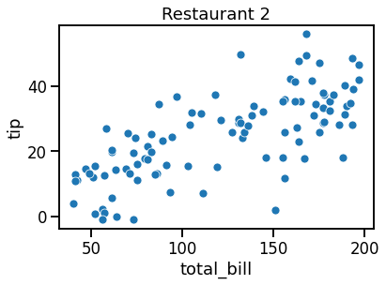
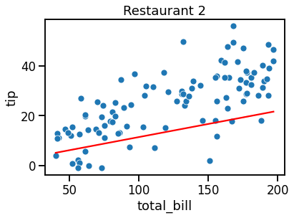
But does Restaurant 1 tip the same as Restaurant 2?
Does the Restaurant 1 model predict data for Restaurant 2?
Restaurant 1 model
Based on how the red line describes the data, it doesn’t look like the Restaurant 1 model describes Restaurant 2 very well
Later, we will quantify this fit

Slide 13
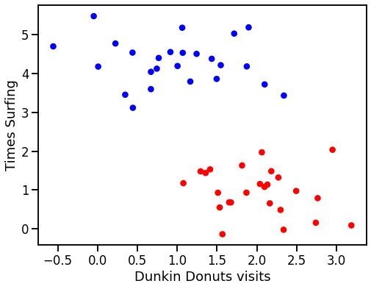
Example 2: classification
Let’s imagine we have 2 features of data with each data point representing an individual
In addition, this data is discretely labeled “east coast” and “west coast”

Slide 14
With these two features, we want to be able to classify whether someone is from the east or west coast
Lots of ways to do this!
Simplest, would be to draw a line between the data

Slide 15

With these two features, we want to be able to classify whether someone is from the east or west coast
Lots of ways to do this!
Simplest, would be to draw a line between the data
Here, we used a linear support vector machine (SVM) to separate the labeled groups

Slide 16
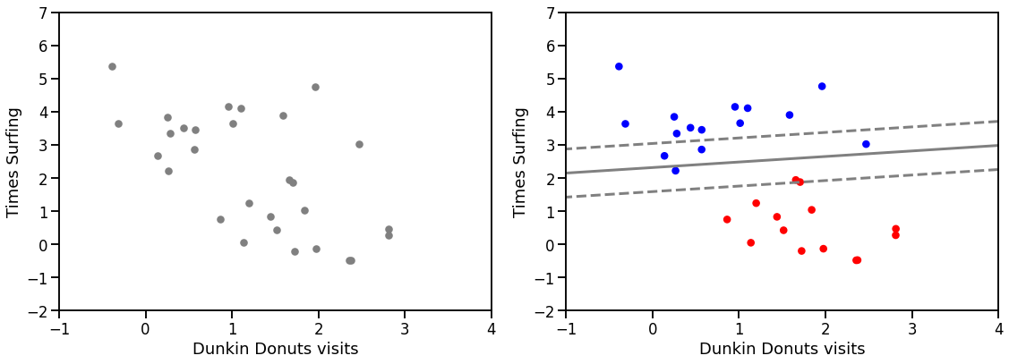
But now, we have some new friends!
Let’s use our model to try to predict whether they are east or west coast
Now, I’ve colored the data based on the truth
We could find the accuracy of this by comparing it to the prediction

Slide 17
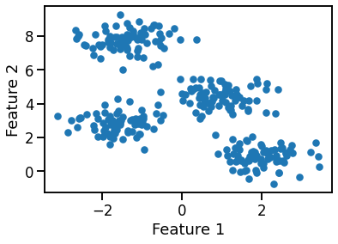
Example 3: Clustering
Sometimes, we may plot data and see clear patterns
Here, it looks like there are multiple clusters of data

Slide 18
However, we don’t actually have labels to differentiate the clusters
We can use an unsupervised machine learning algorithm called k-means clusters

Slide 19
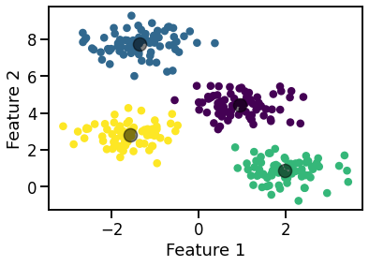
However, we don’t actually have labels to differentiate the clusters
We can use an unsupervised machine learning algorithm called k-means clusters
Without labels, we can’t quantify how well this worked, but it does perhaps help us understand the data!

Slide 20
Plan for last half of the session:
Supervised: Linear regression
Univariate vs multivariate
Quantifying prediction error
Polynomial and logistic regression
Supervised: binary classification
Decision Trees, Logistic Regression, and SVM
Metrics for quantification
ROC, AUC
Precision-recall
Cross-validation
Unsupervised: Clustering
K-means
Unsupervised: Dimensionality reduction
Principle component analysis
Use all the skills we developed in the first half + work on final project

Slide 21
Final notes:
Scikit-learn to do most of this
https://scikit-learn.org/stable/
Data as tables (dataframes)
Feature matrix (2-d) = columns are unique features
Represented as X
Independent or explanatory variable
Target array (1-d) = trying to predict from the data
Represented as y
Dependent or response variable

Slide 22
How Scikit-learn works:
Choose a class of model
Choose model hyperparameters
Arrange data into a features matrix and target vector following the discussion above.
Fit the model to your data by calling the fit() method of the model instance.
Apply the Model to new data:
For supervised learning, often we predict labels for unknown data using the predict() method.
For unsupervised learning, we often transform or infer properties of the data using the transform() or predict() method.

Slide 23
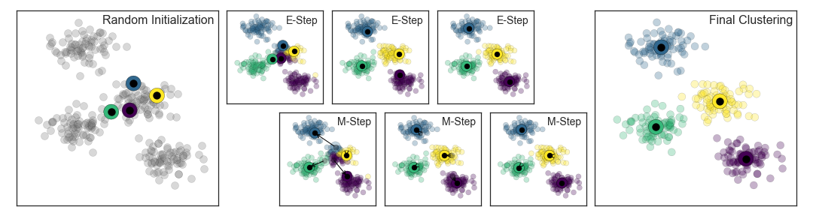
Cool figure showing how k-means clustering works
We will talk more about this

